Slide 1
BATCH 2
SOLID PROPULSION REPORT

Slide 2
THIS WEEK’S OBJECTIVES.
DESIGN & FABRICATE CASING FOR THE ELECTRONICS.
FINALIZE ON GETTING THE 2 ½ INCH SCH40 PIPE.
START AND FINISH WORKING ON THE 1 GRAIN MOTOR CASE.
COOK GRAIN AND EXPLORE METHODS OF PRESERVATION.

Slide 3
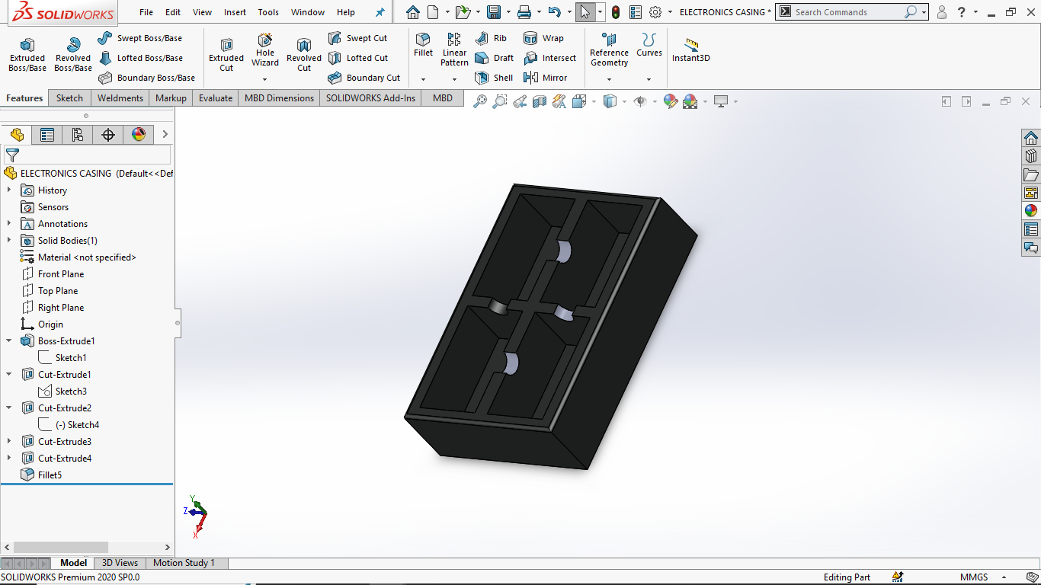
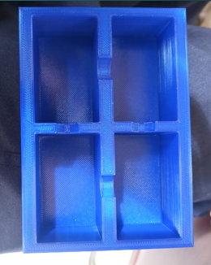
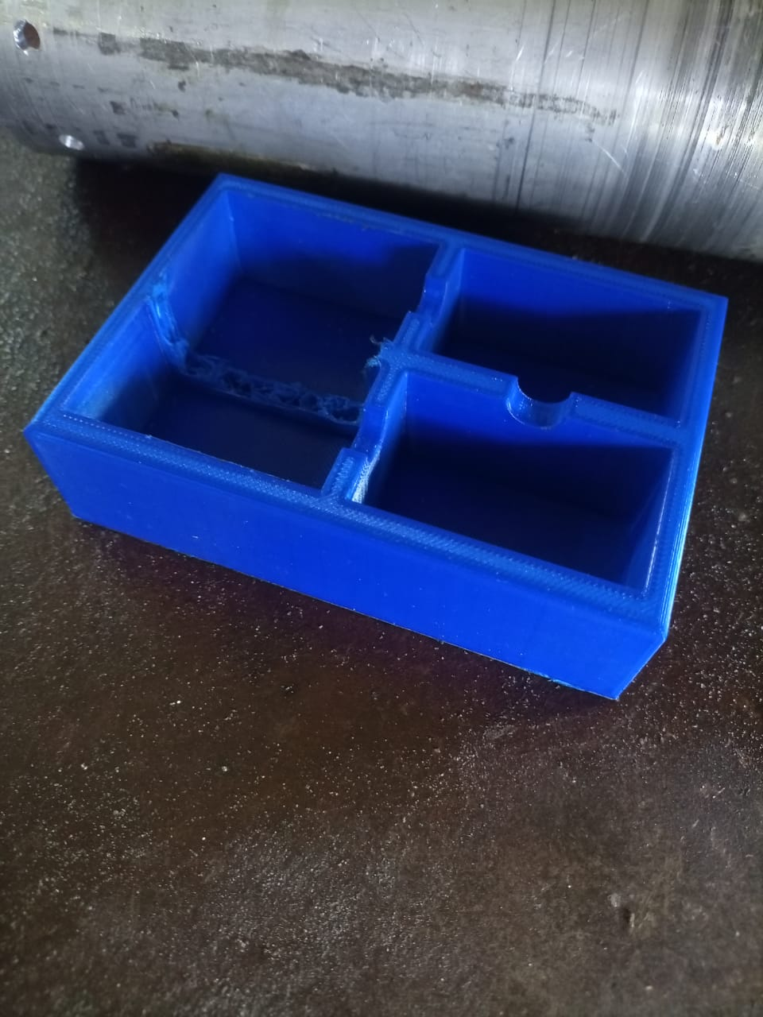
DESIGN & FABRICATE CASING FOR THE ELECTRONICS.

Slide 4
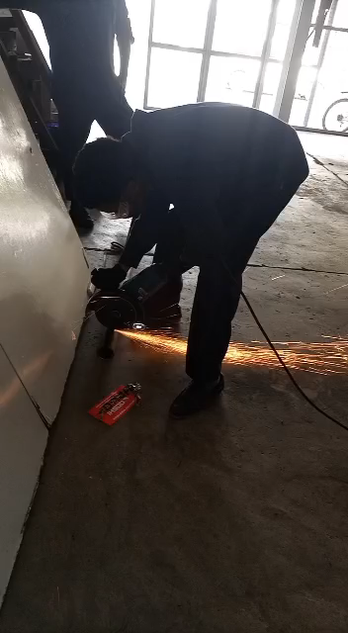
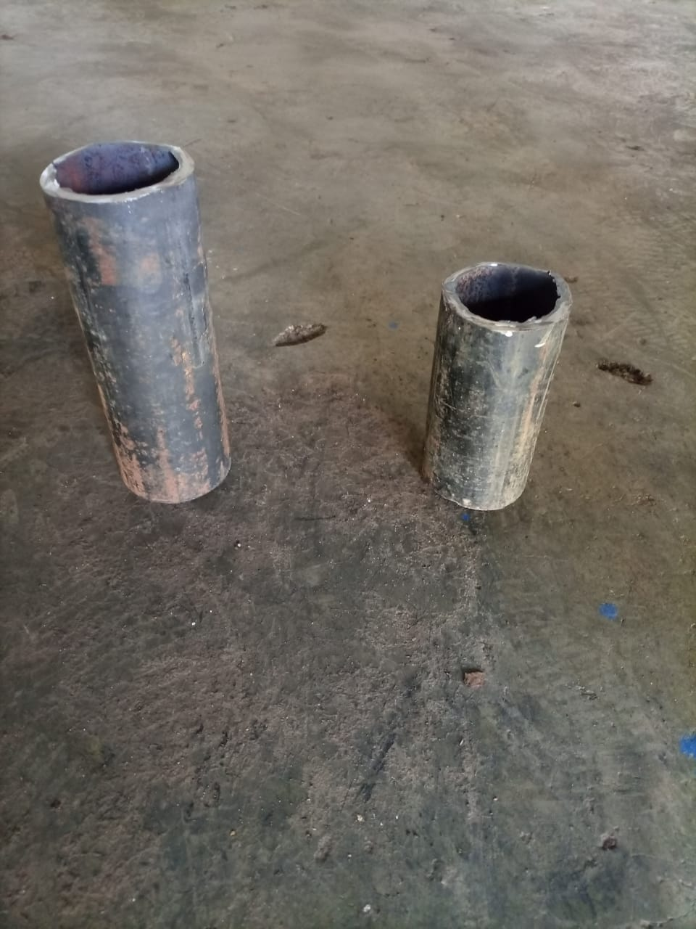
FINALIZE ON GETTING THE 2 ½ INCH SCH40 PIPE.
1 Grain casing & mould casing

Slide 5
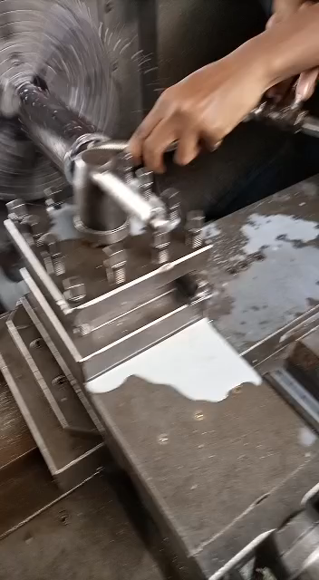
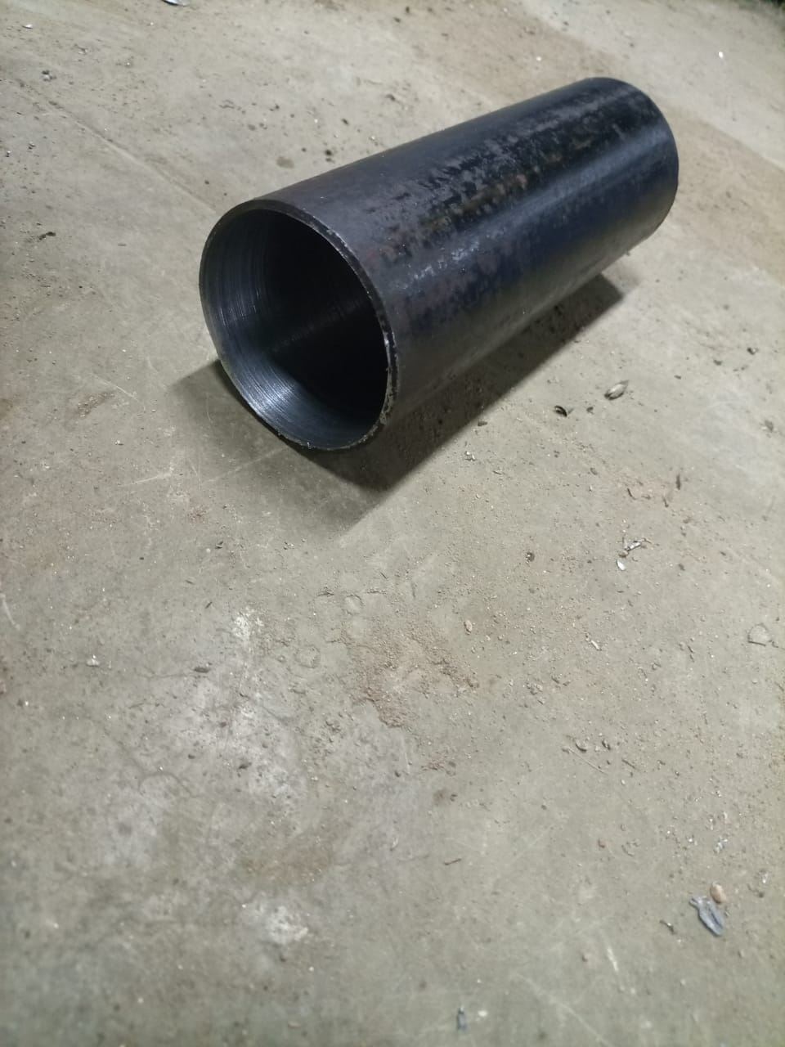
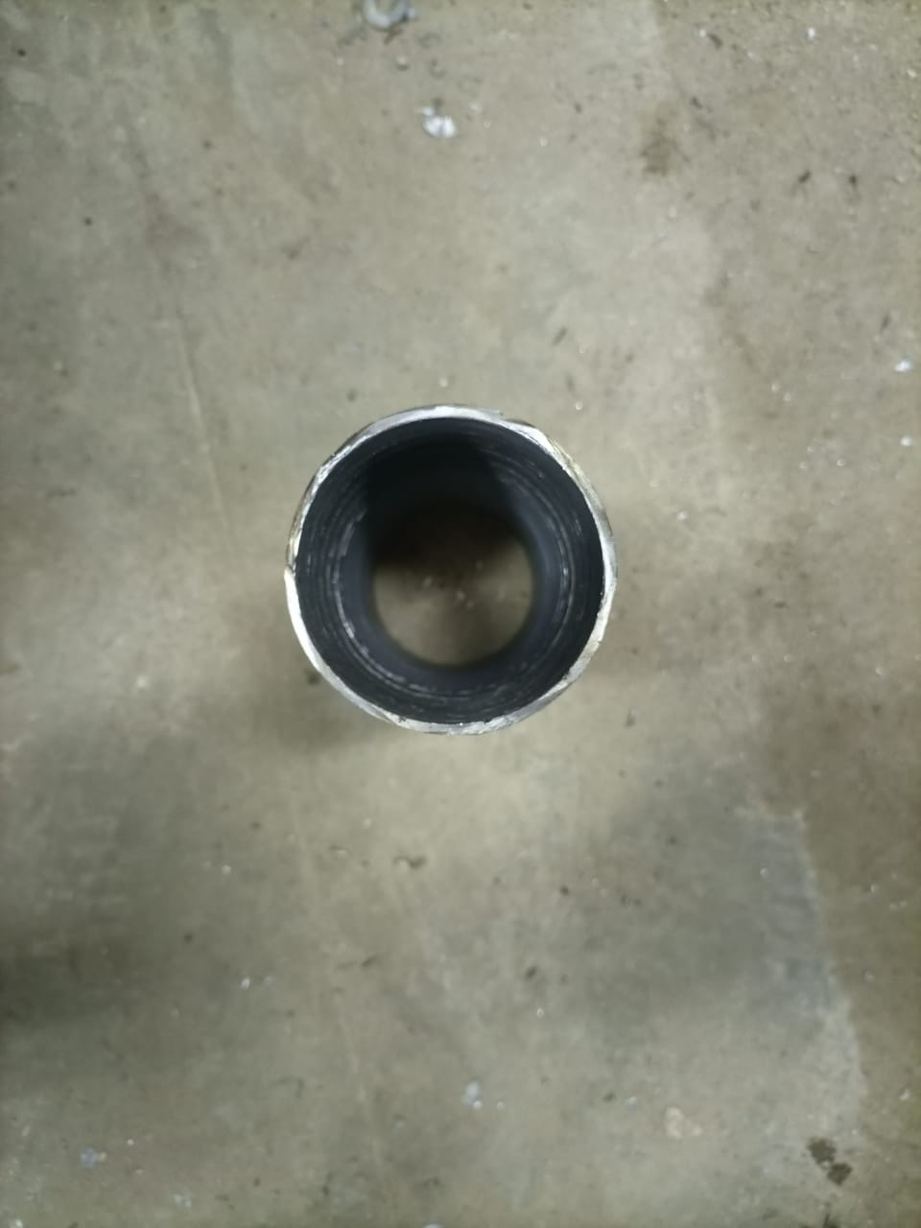
START WORKING ON THE 1 GRAIN MOTOR CASE.
1 GRAIN CASING
Internal diameter= 68mm

Slide 6
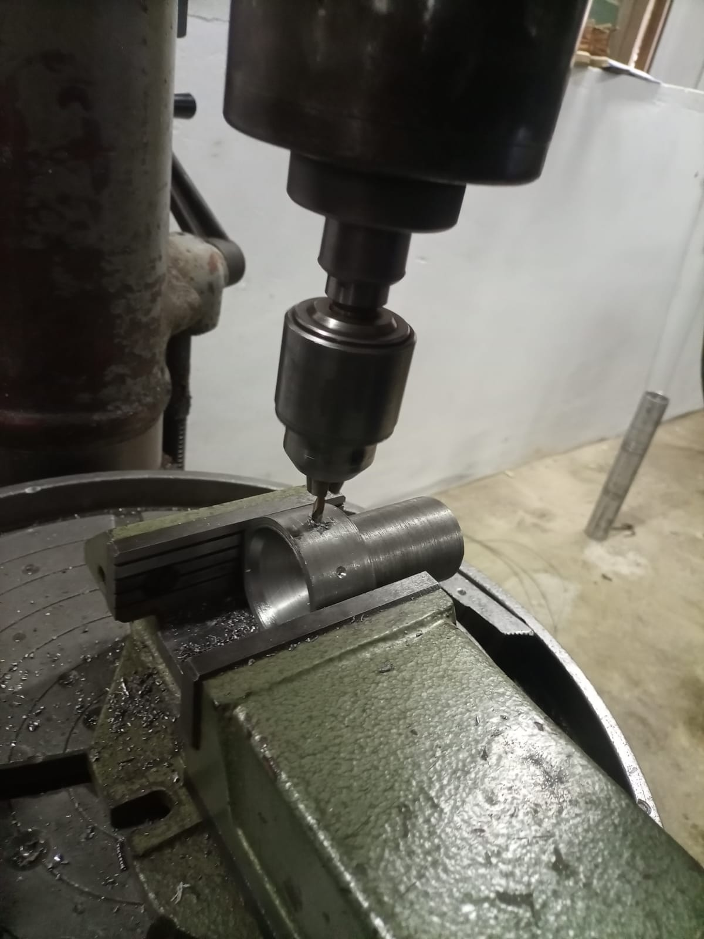
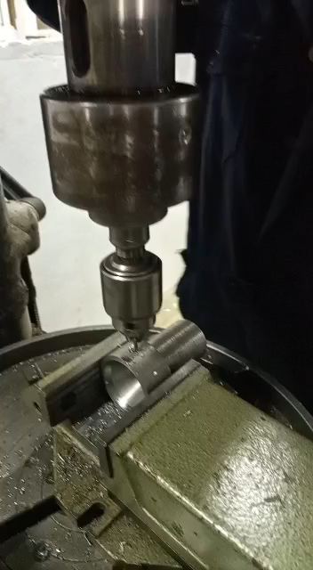
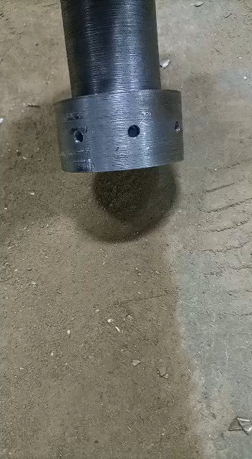
Nozzle drilling

Slide 7
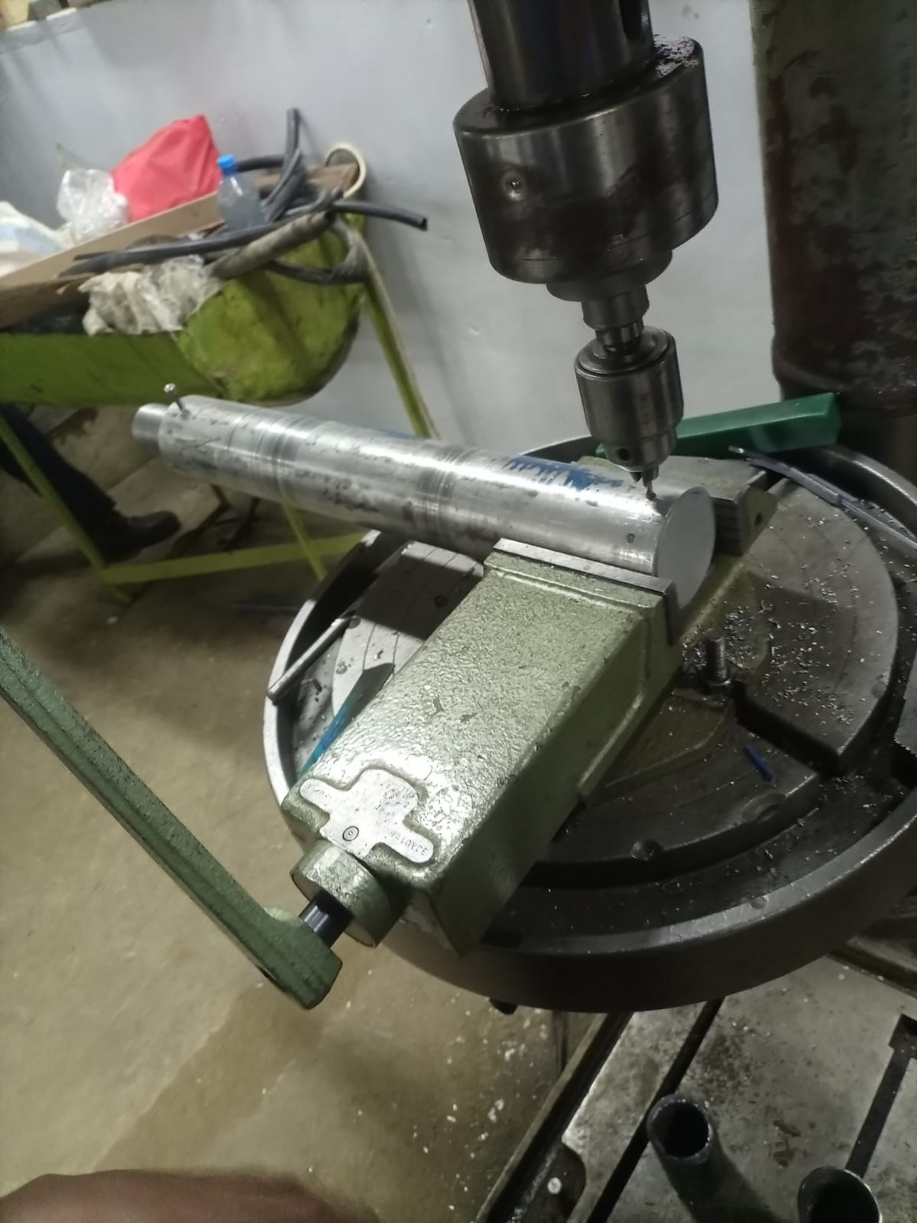
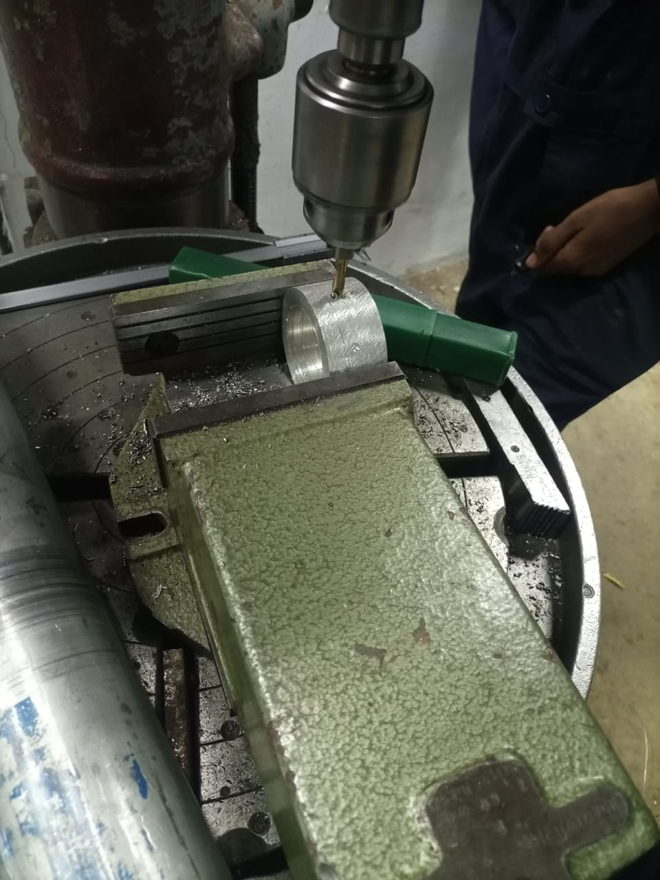
Bulkhead drilling

Slide 8
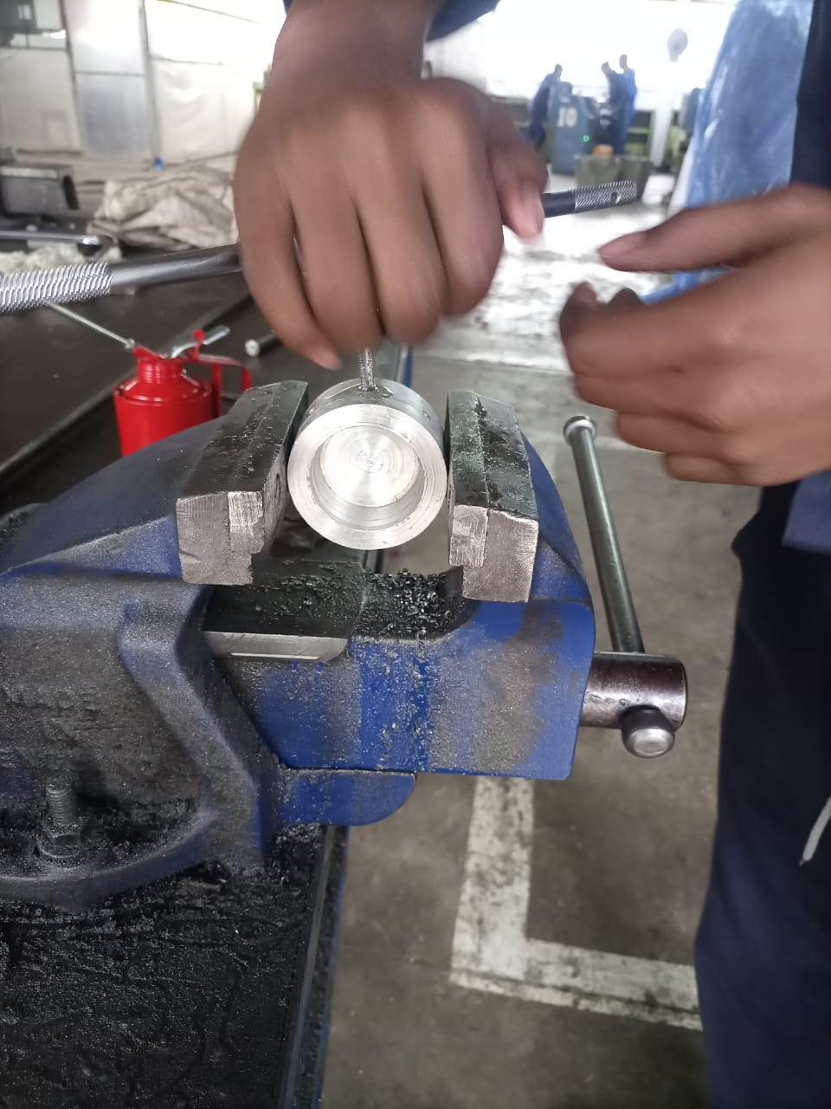
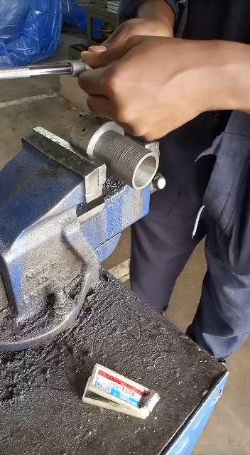
TAPPING OF BULKHEAD & NOZZLE

Slide 9
COOK GRAIN AND EXPLORE METHODS OF PRESERVATION.
In progress.

Slide 10
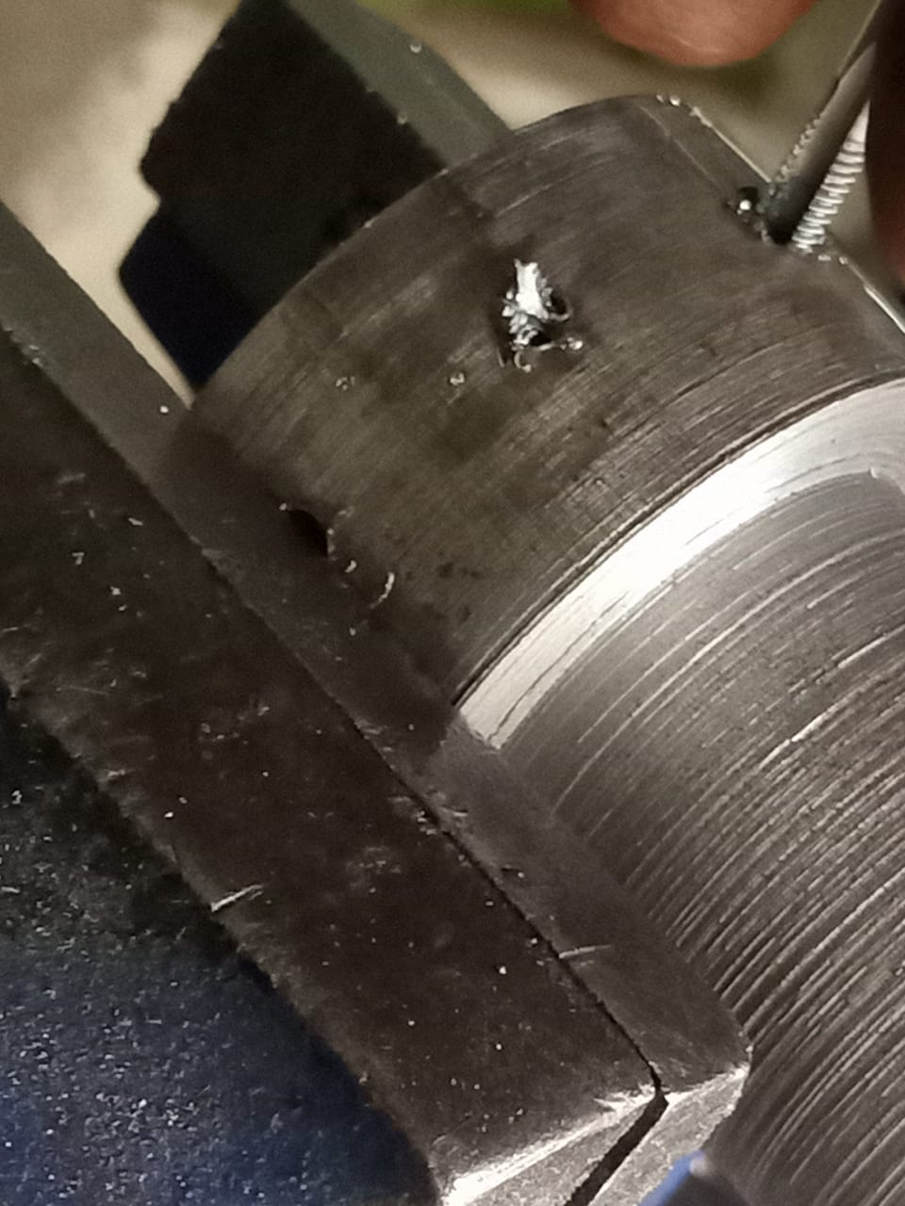
CHALLENGES ENCOUNTERED.
Breaking of tapping tool.

Slide 11
NEXT WEEK’S OBJECTIVES.
PERFORM FIRST STATIC TEST.
DESIGN OF COMPRESSION MECHANISM- MOULD ASSEMBLY.
CONFIGURATION OF COMMUNICATING TWO ESP MODULES.
COOK 2 GRAINS.

